Slide 1

Analyzing streaming giants: A Comparative Study of Netflix and Amazon Prime Video
Group 6
Sudiksha Acharya
Archana Murthy Pullela Venkata
Ravi Kumar Ram
Rohith Arcott
Lalith Raj

Slide 2

Agenda
Introduction and Goal
Streaming Services – Market Share Overview
Content evolution and Diversity
Original Content
Cost Analysis
Monetization
Engagement
Conclusion
Q&A

Slide 3

Goal
Present a comparative study of Netflix and Amazon Prime Video and provide insights into
Target Audience:
New streaming players in the market
Production houses
Netflix and Prime Video

Slide 4
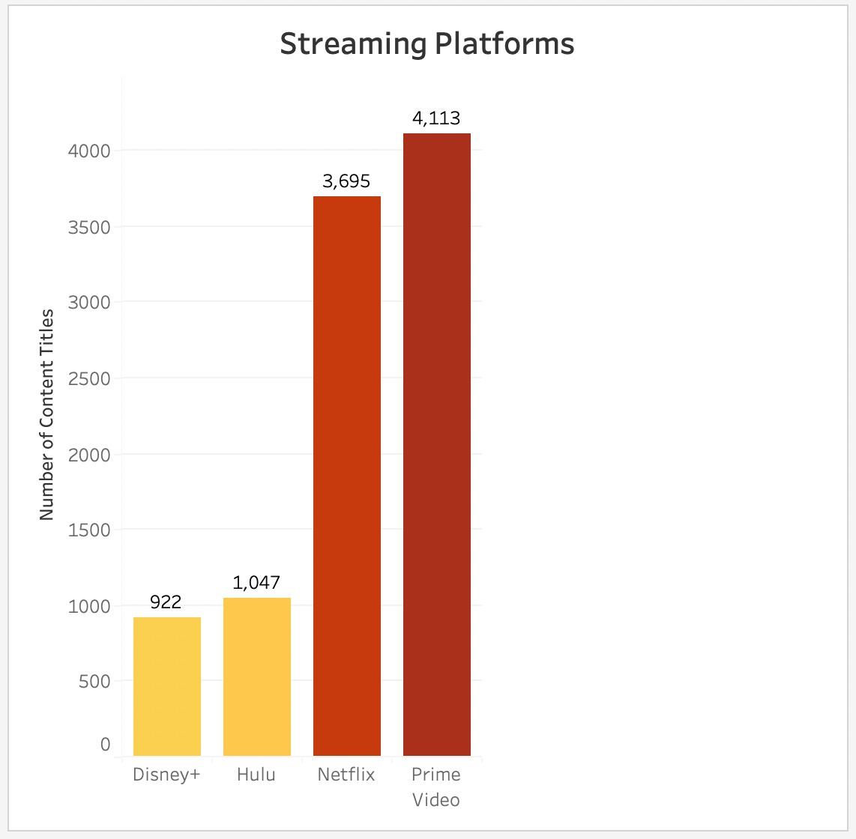
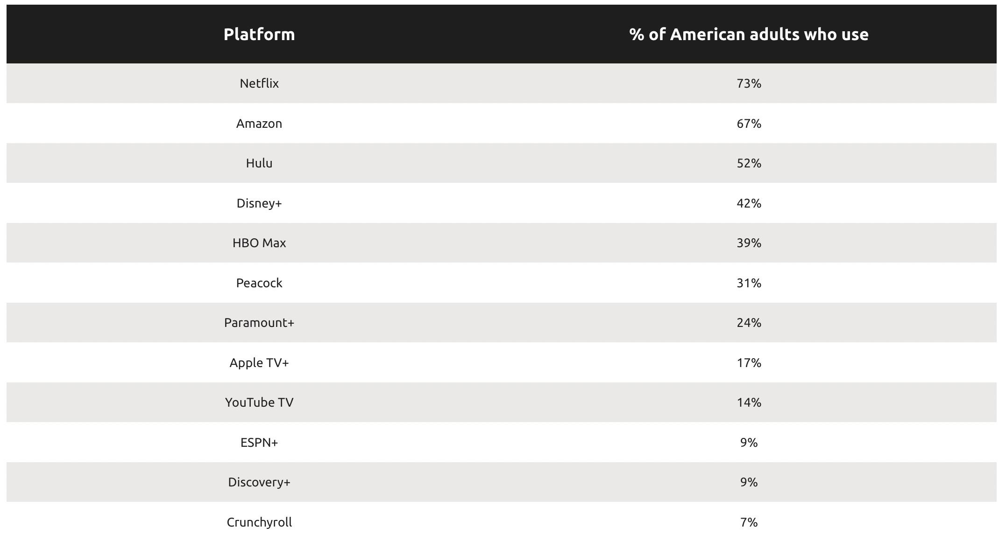
Streaming Platforms Popularity – Content Market Share
Source:https://cordcutting.com/research/state-of-streaming-report/

Slide 5
CONTENT is key.... How much choice do the users have?

Slide 6
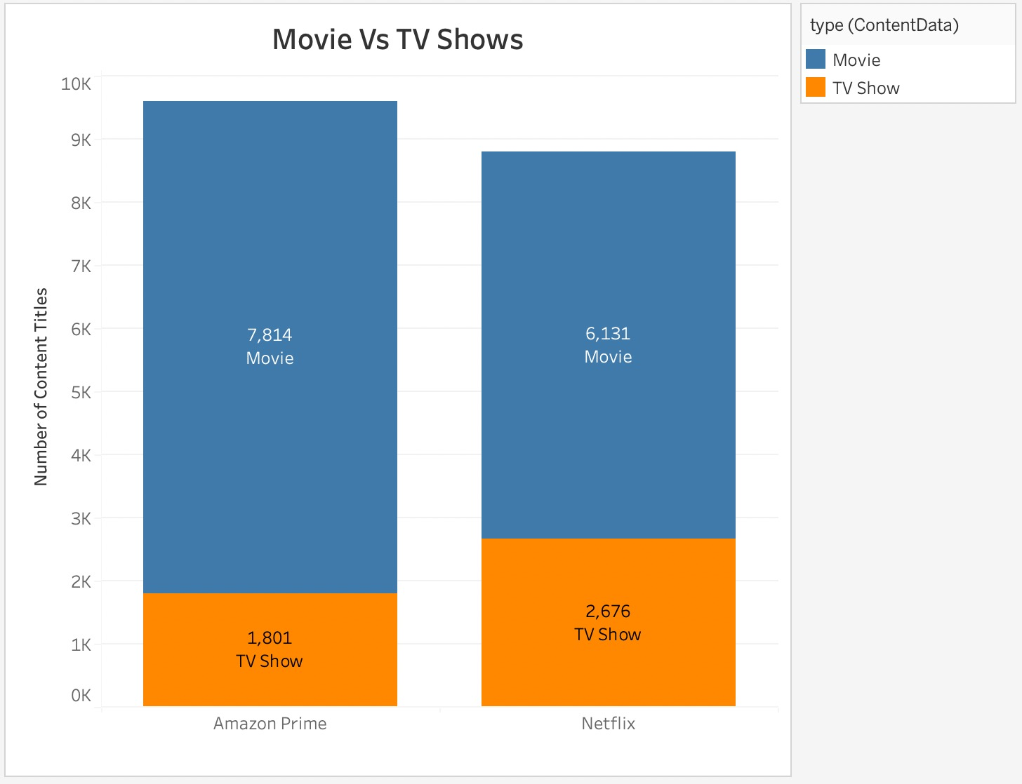

Slide 7
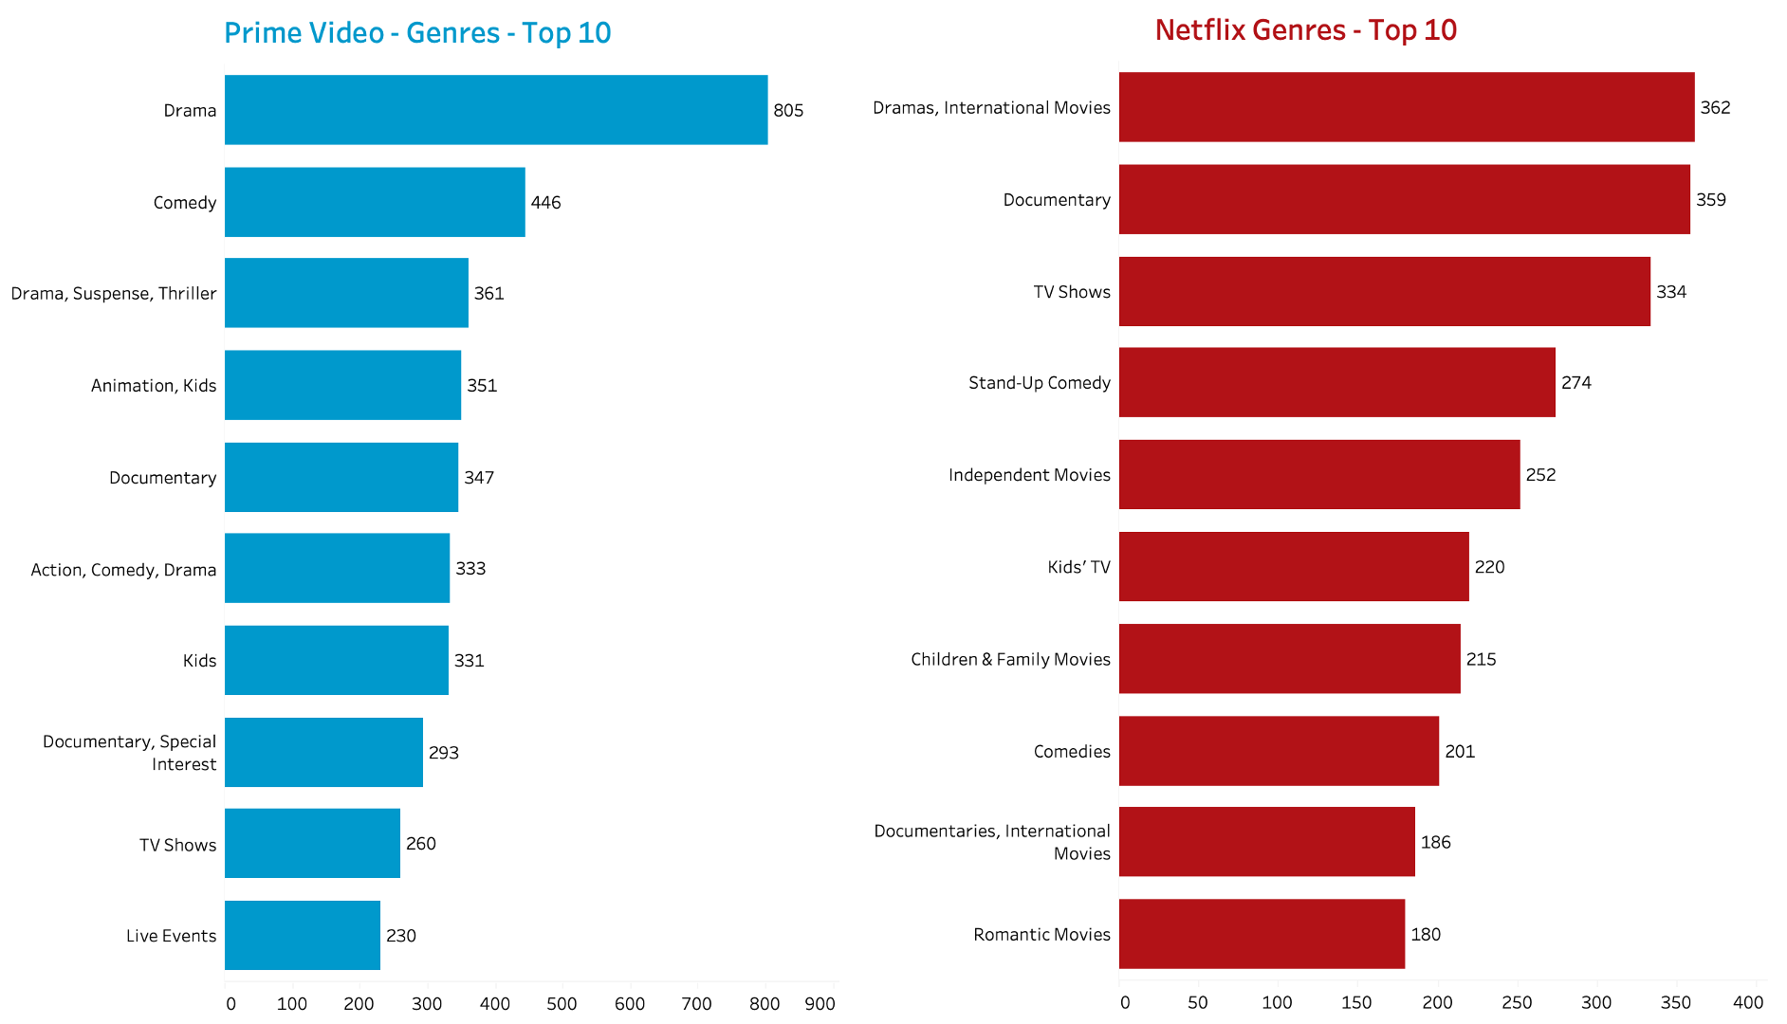

Slide 8
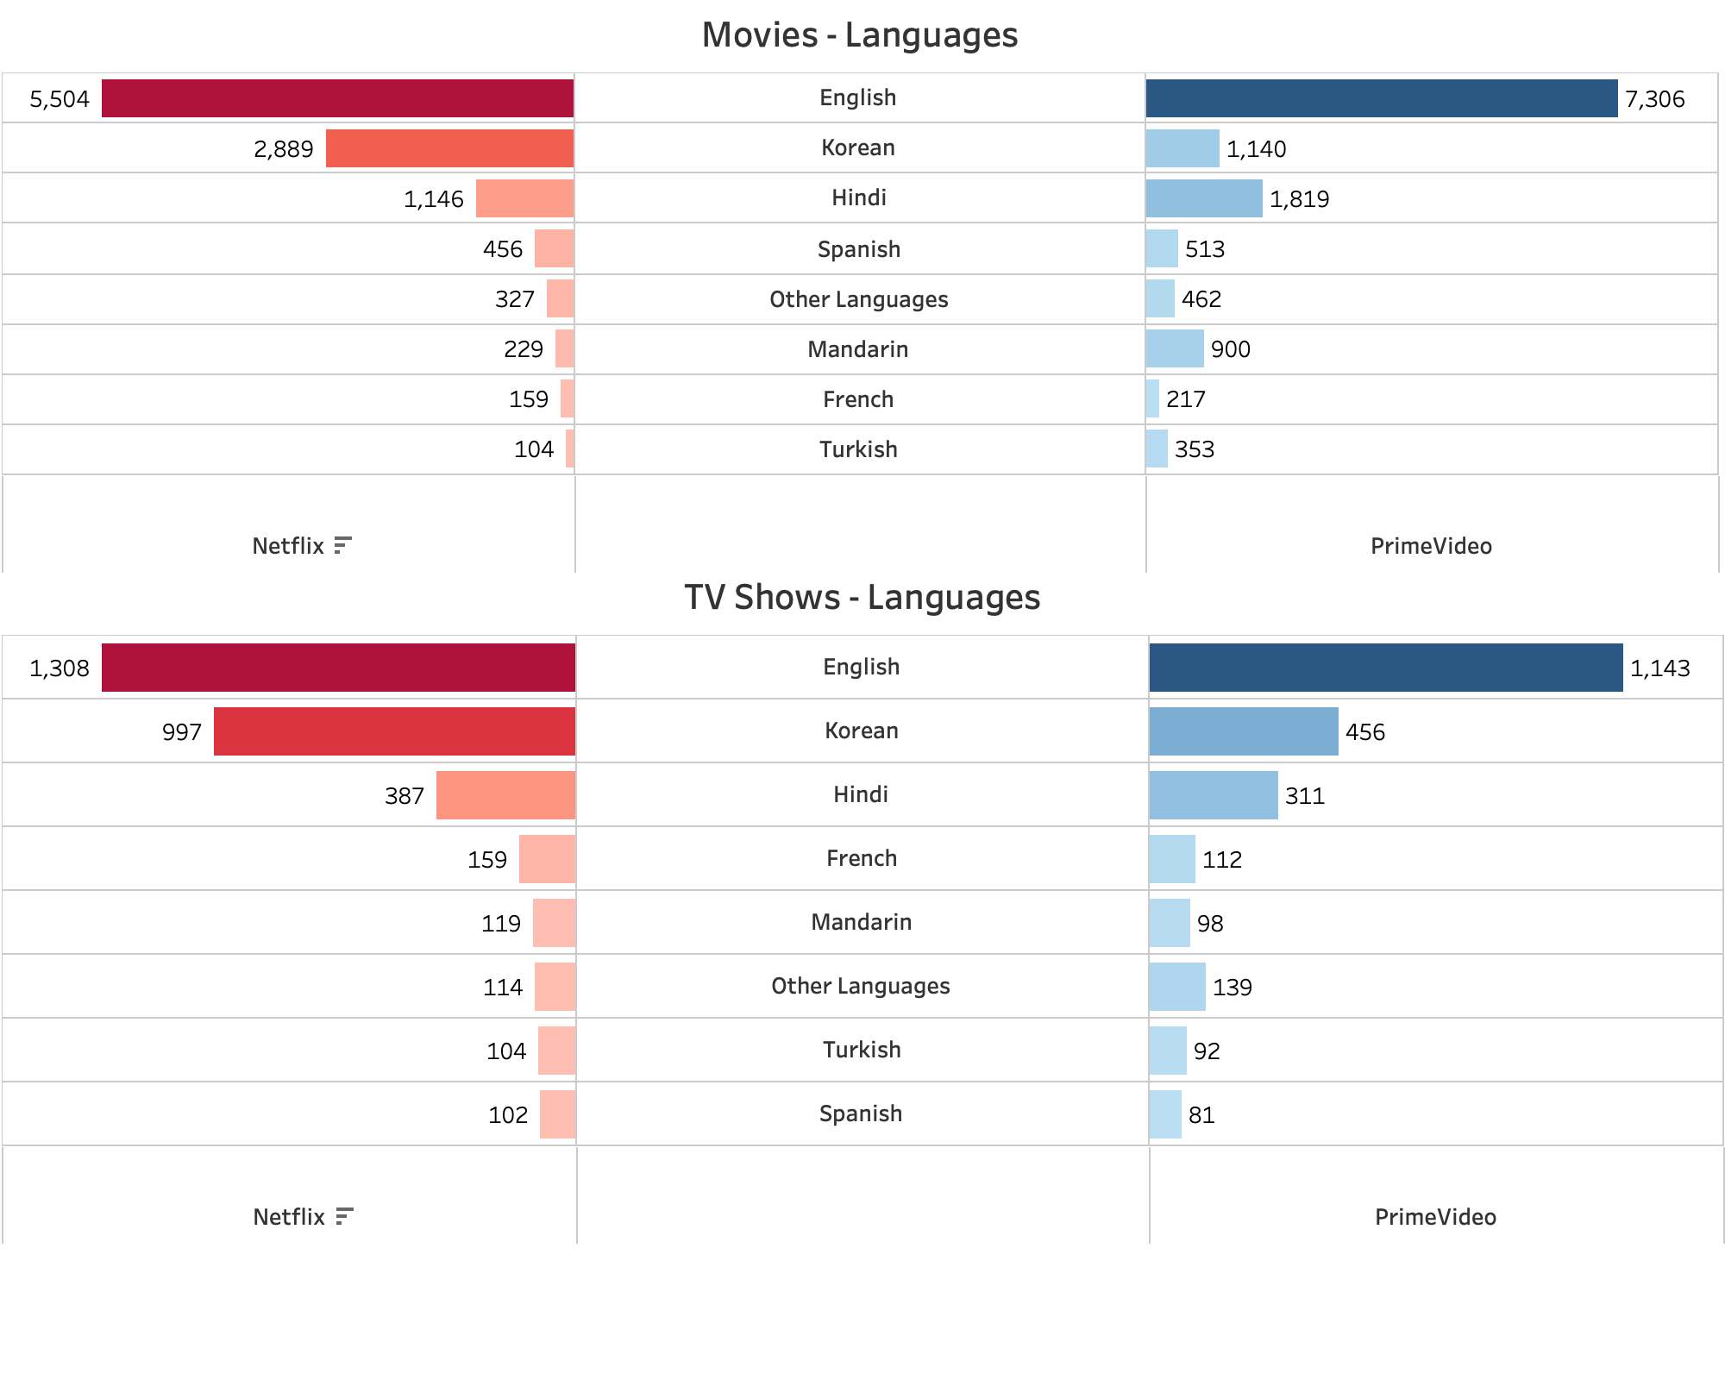

Slide 9
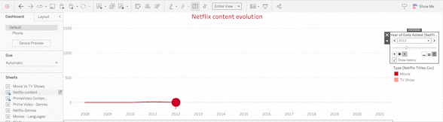
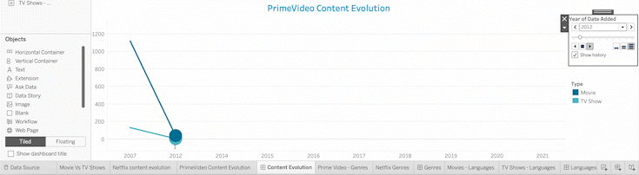

Slide 10
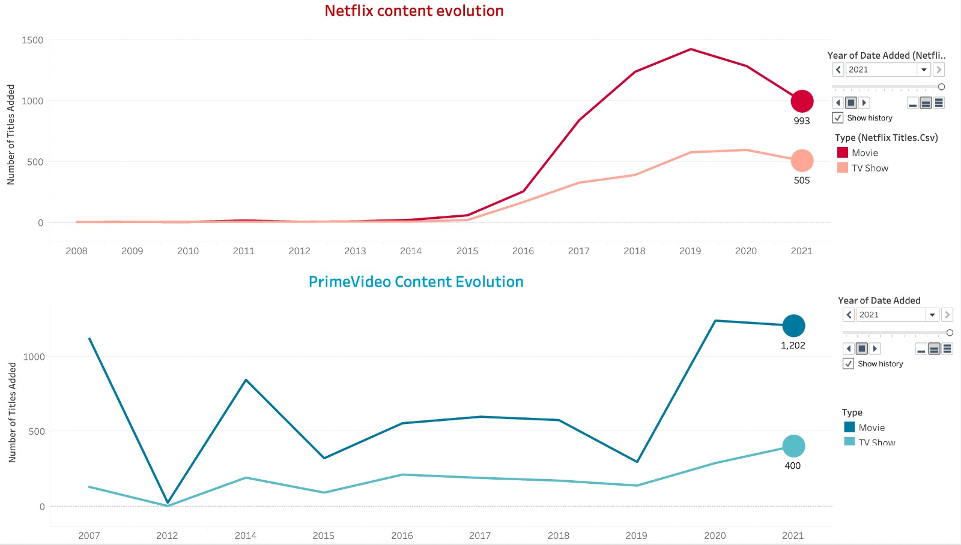

Slide 11
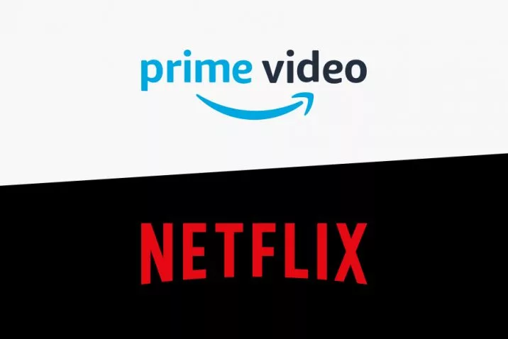
Original content

Slide 12
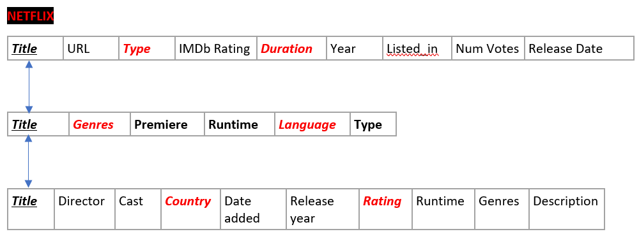
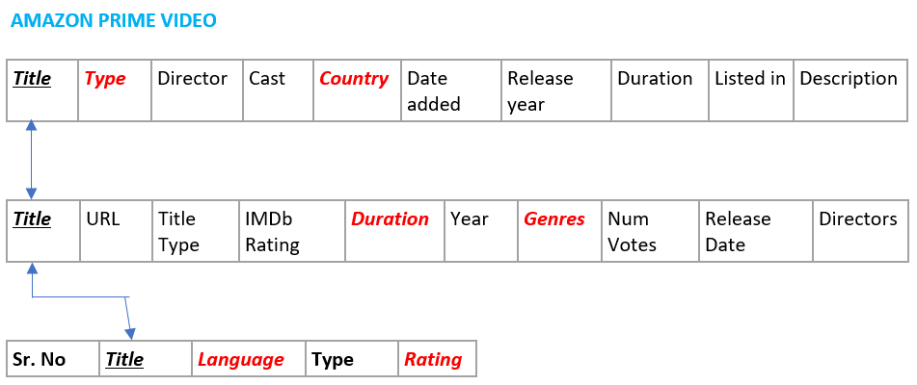
Data source and relationships

Slide 13
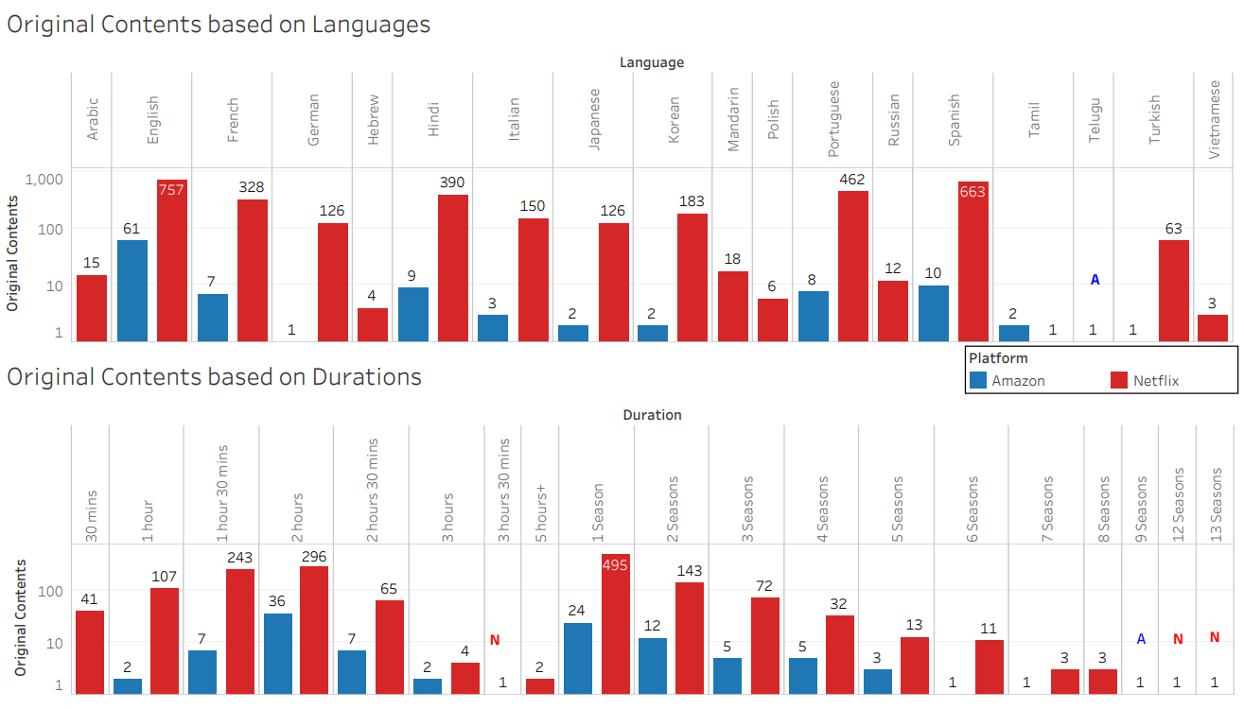
Original Content comparison based on various categories
Languages and Durations

Slide 14
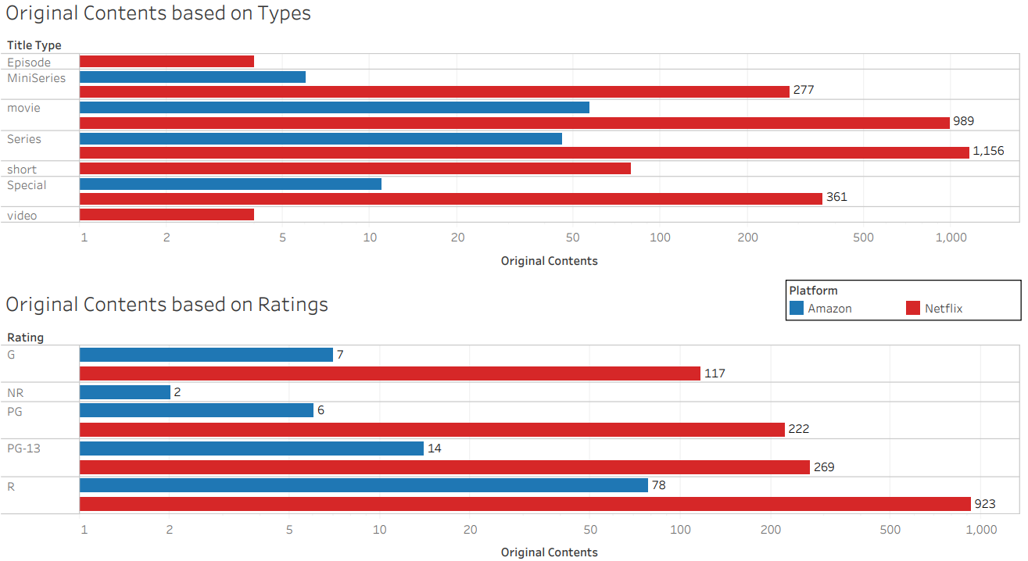
Content Types and Ratings

Slide 15
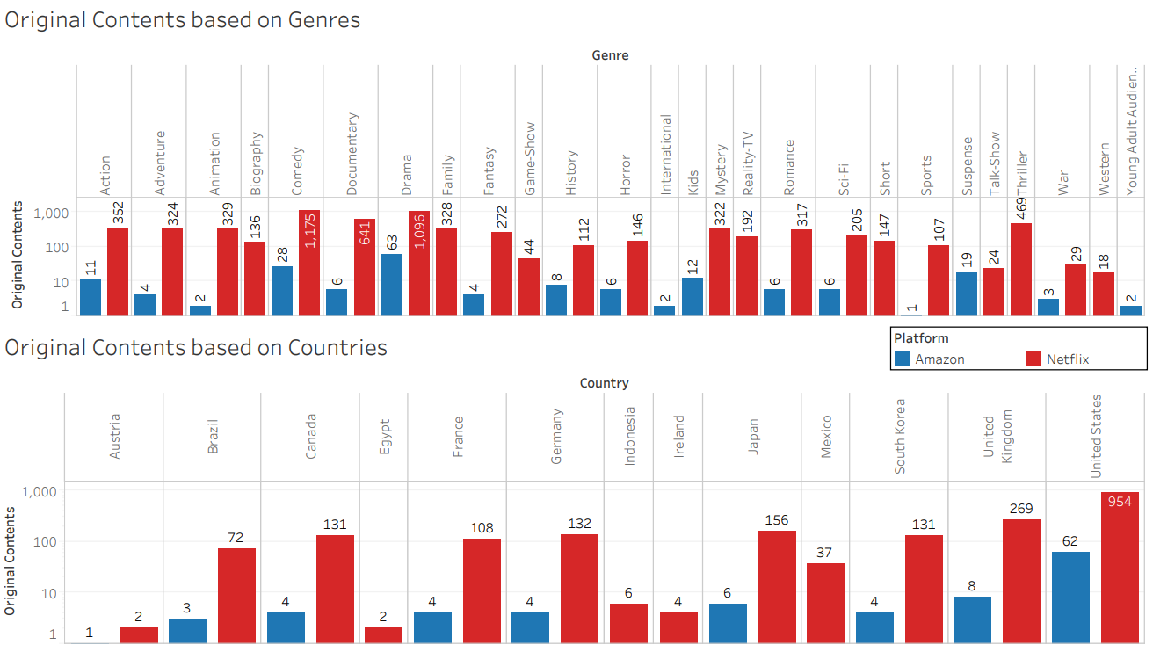
Genres and Countries

Slide 16
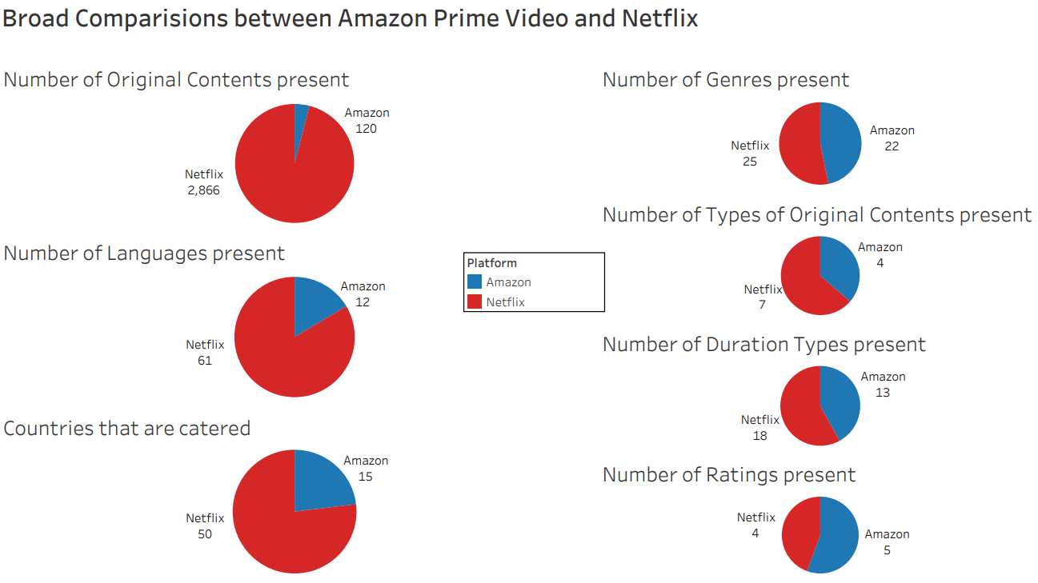
Summary of original contents for these categories

Slide 17

Subscription Price Comparison for OTT Platforms

Slide 18
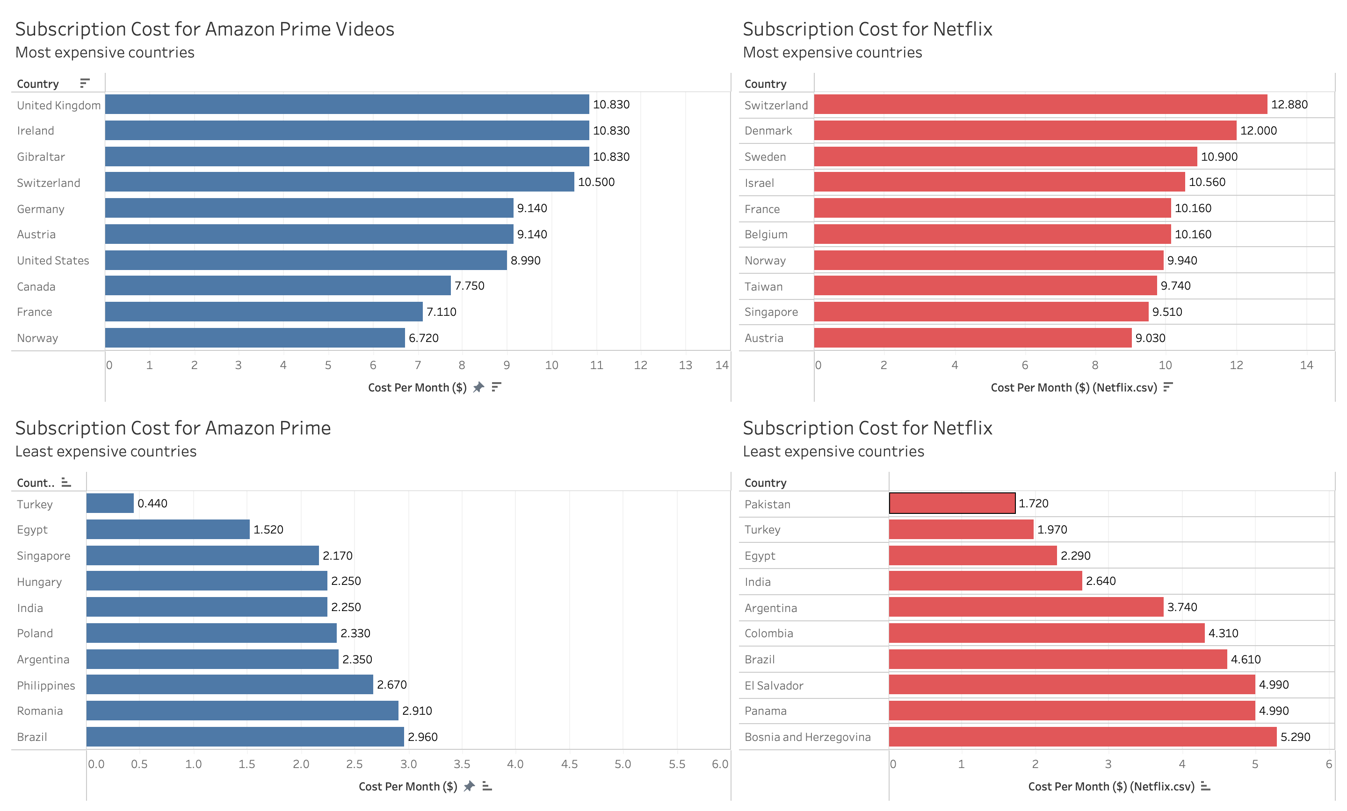
Subscription cost analysis

Slide 19
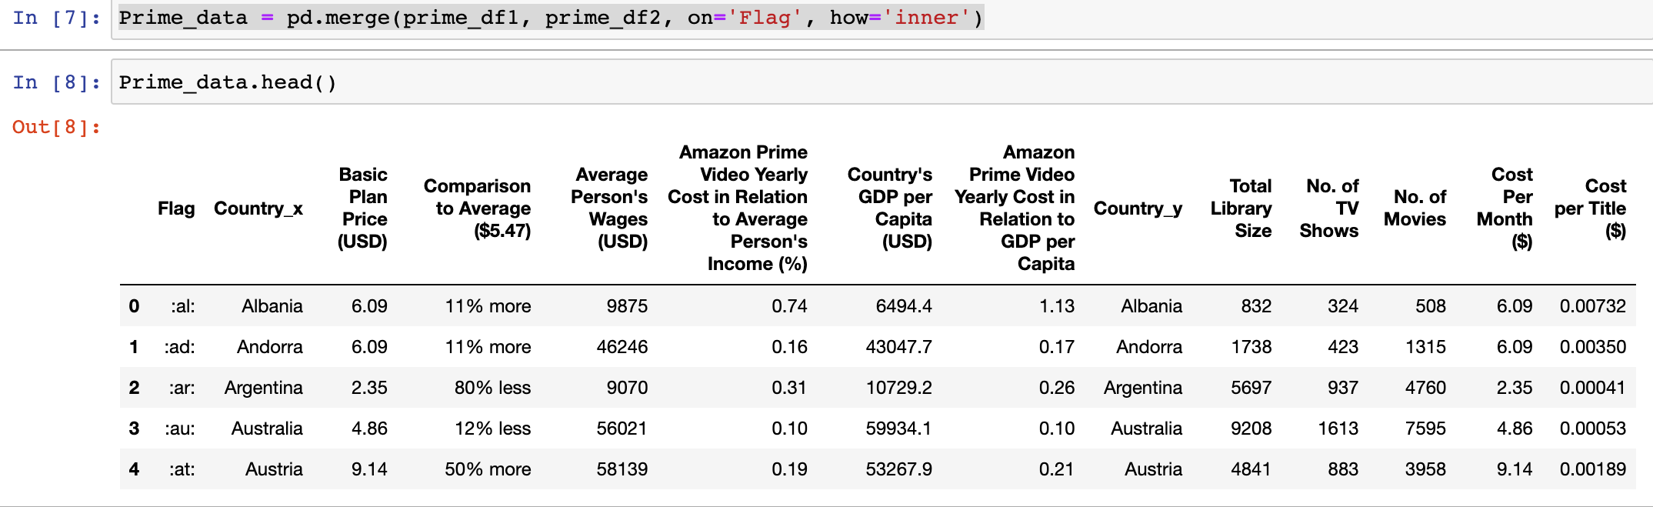
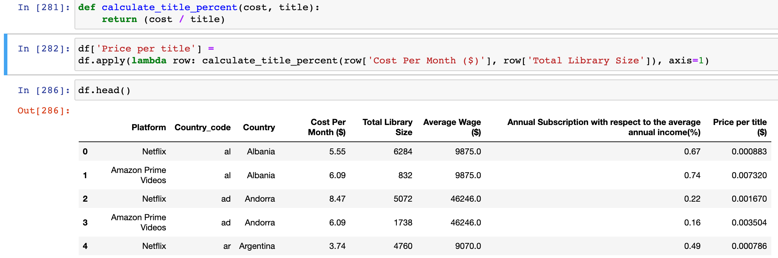
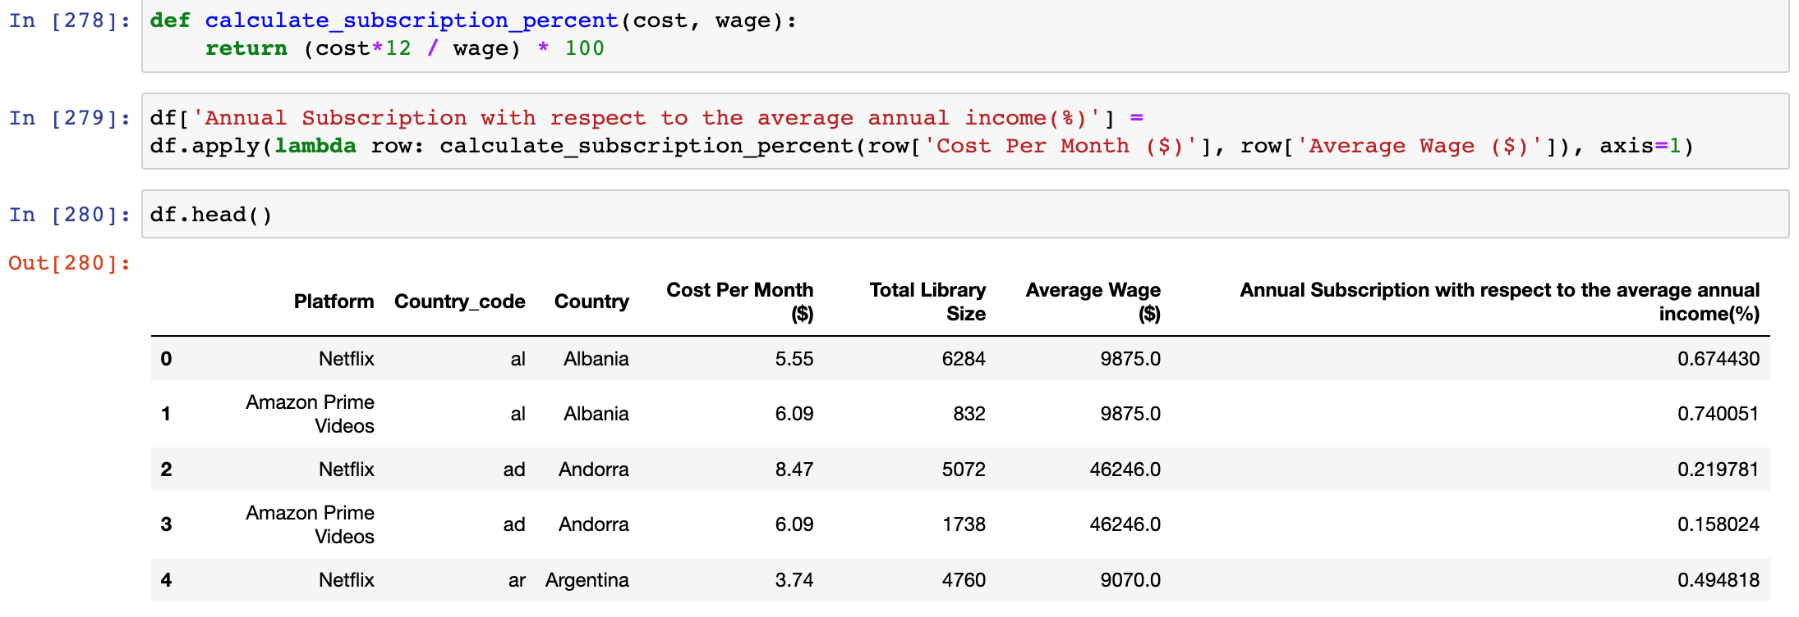
Metrics for Price Comparison across countries
Price Per Title
Subscription cost with respect to the average wage of a country

Slide 20
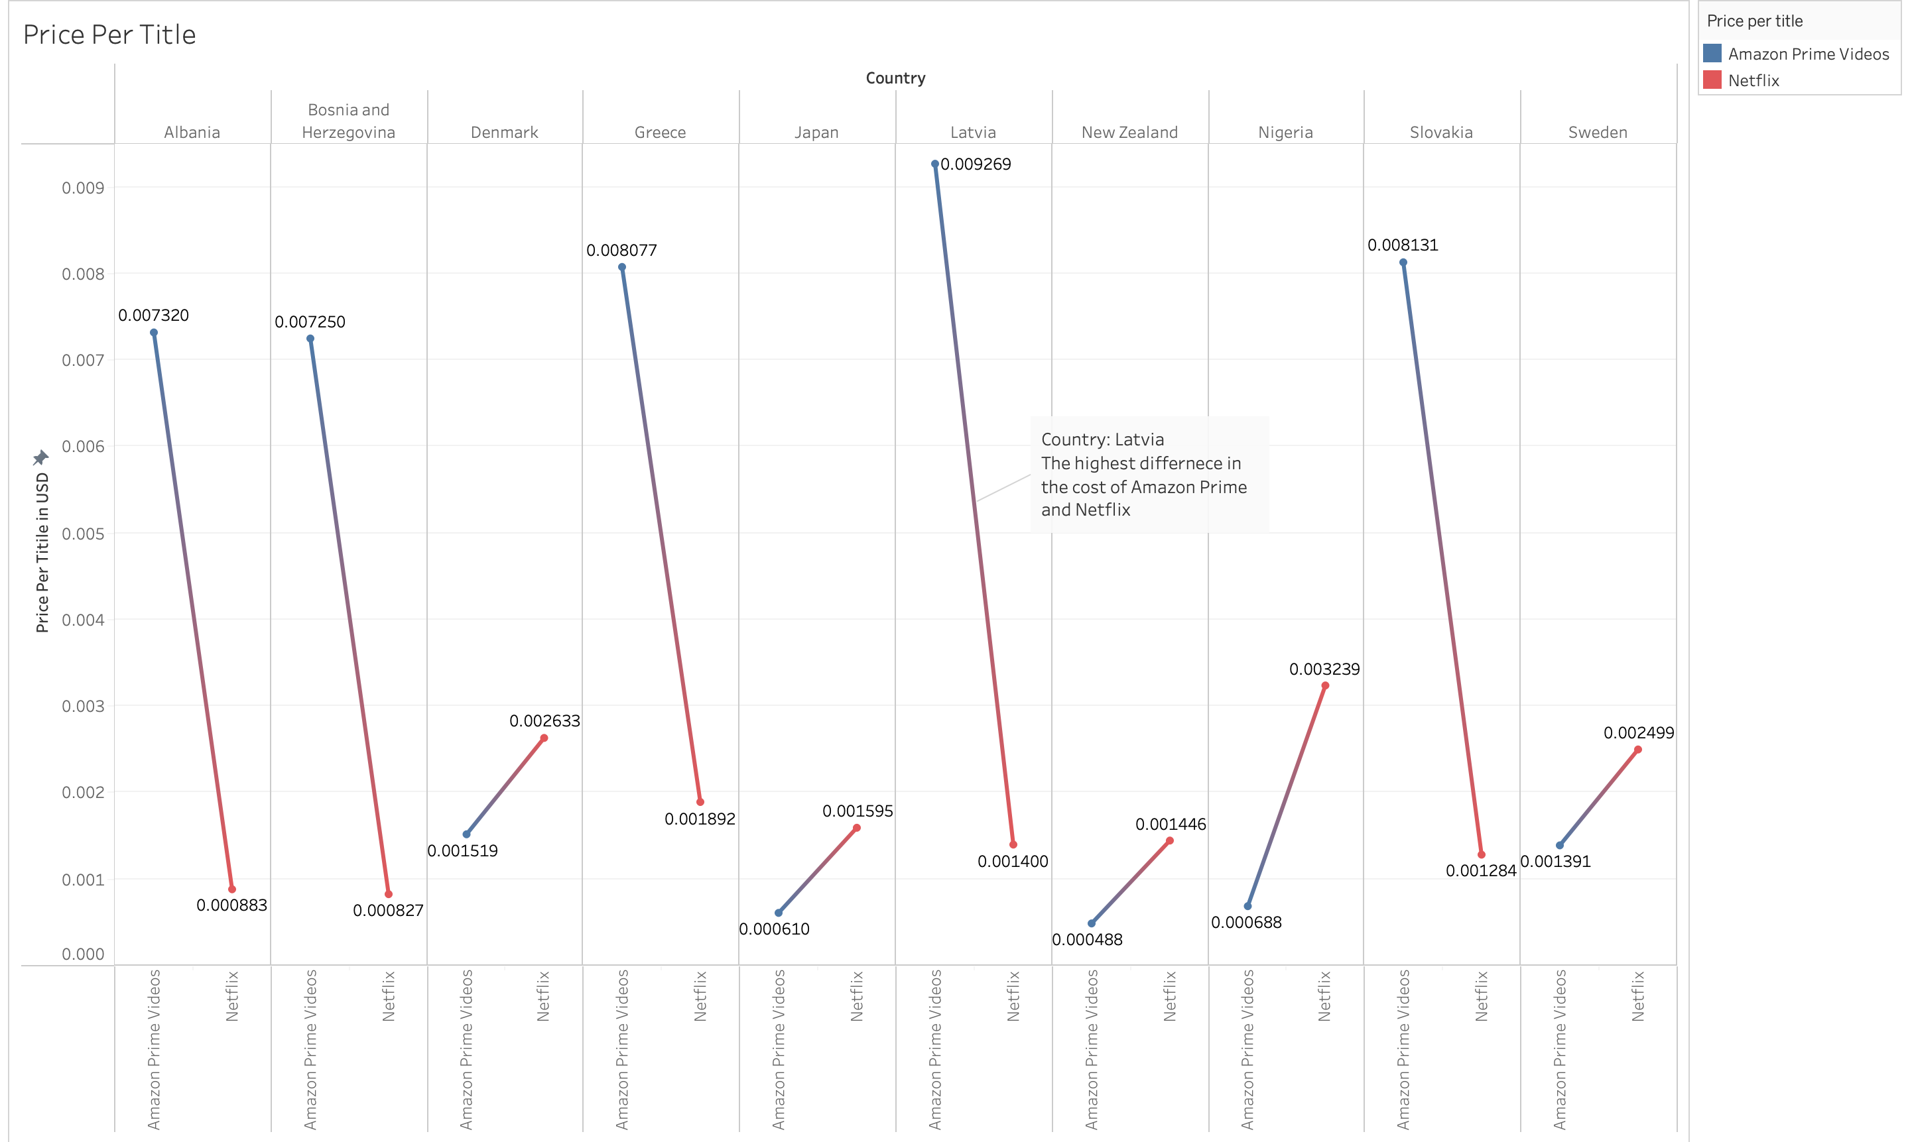
Price per title – Countries with Highest Difference

Slide 21
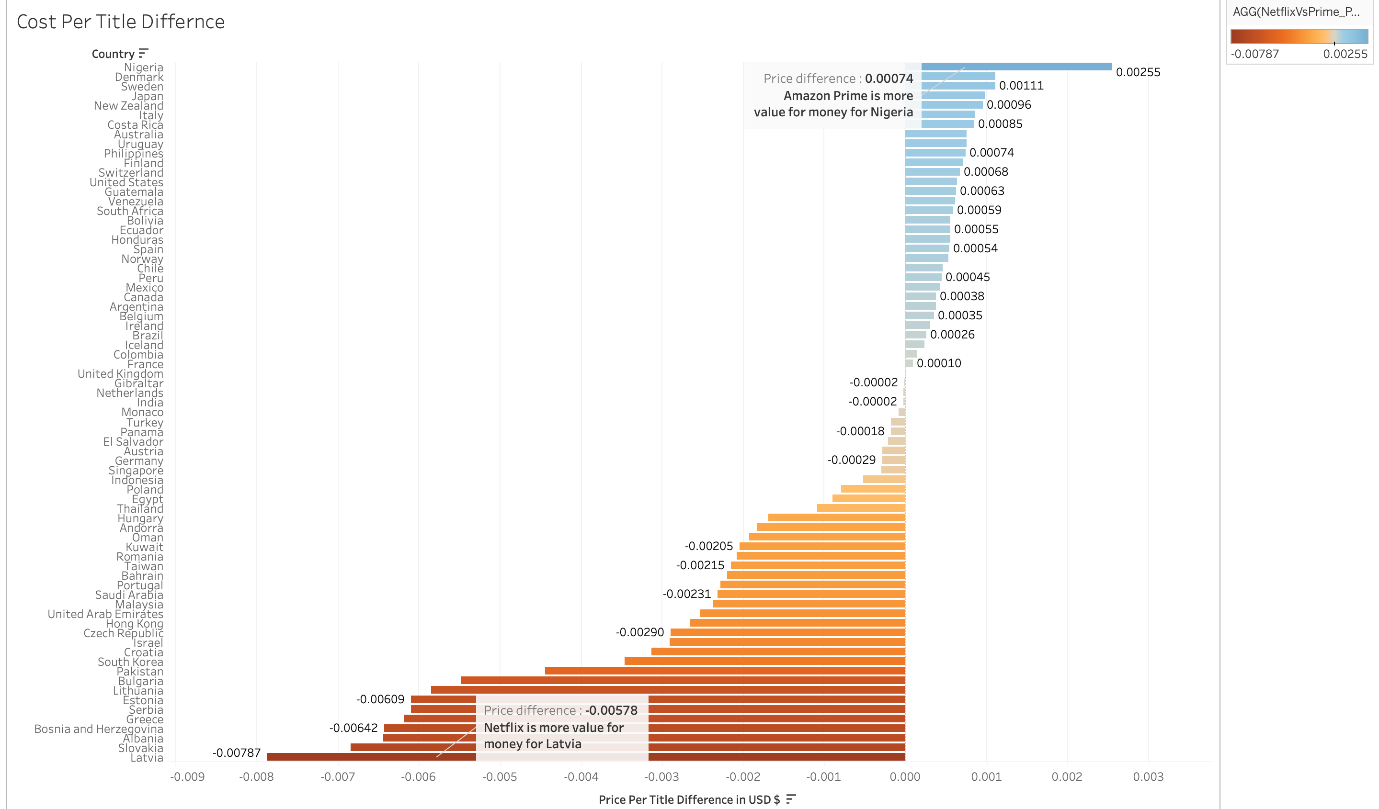
Price per Title

Slide 22
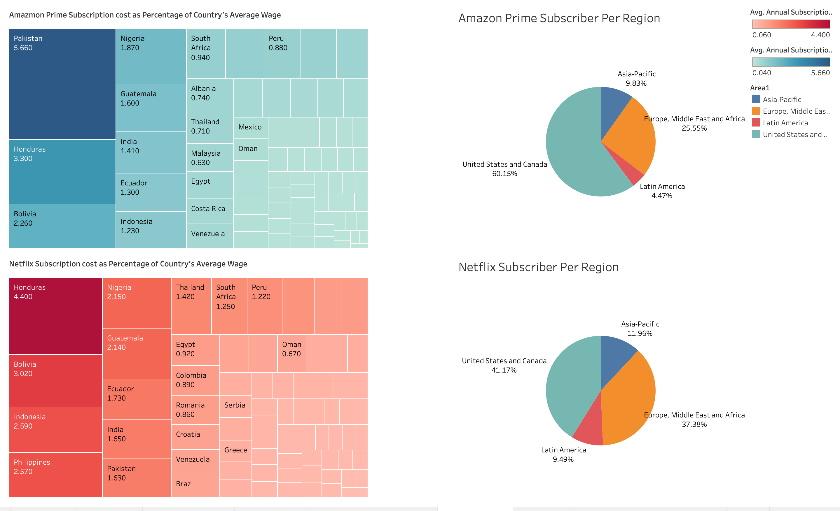
Subscription cost with respect to average wage

Slide 23
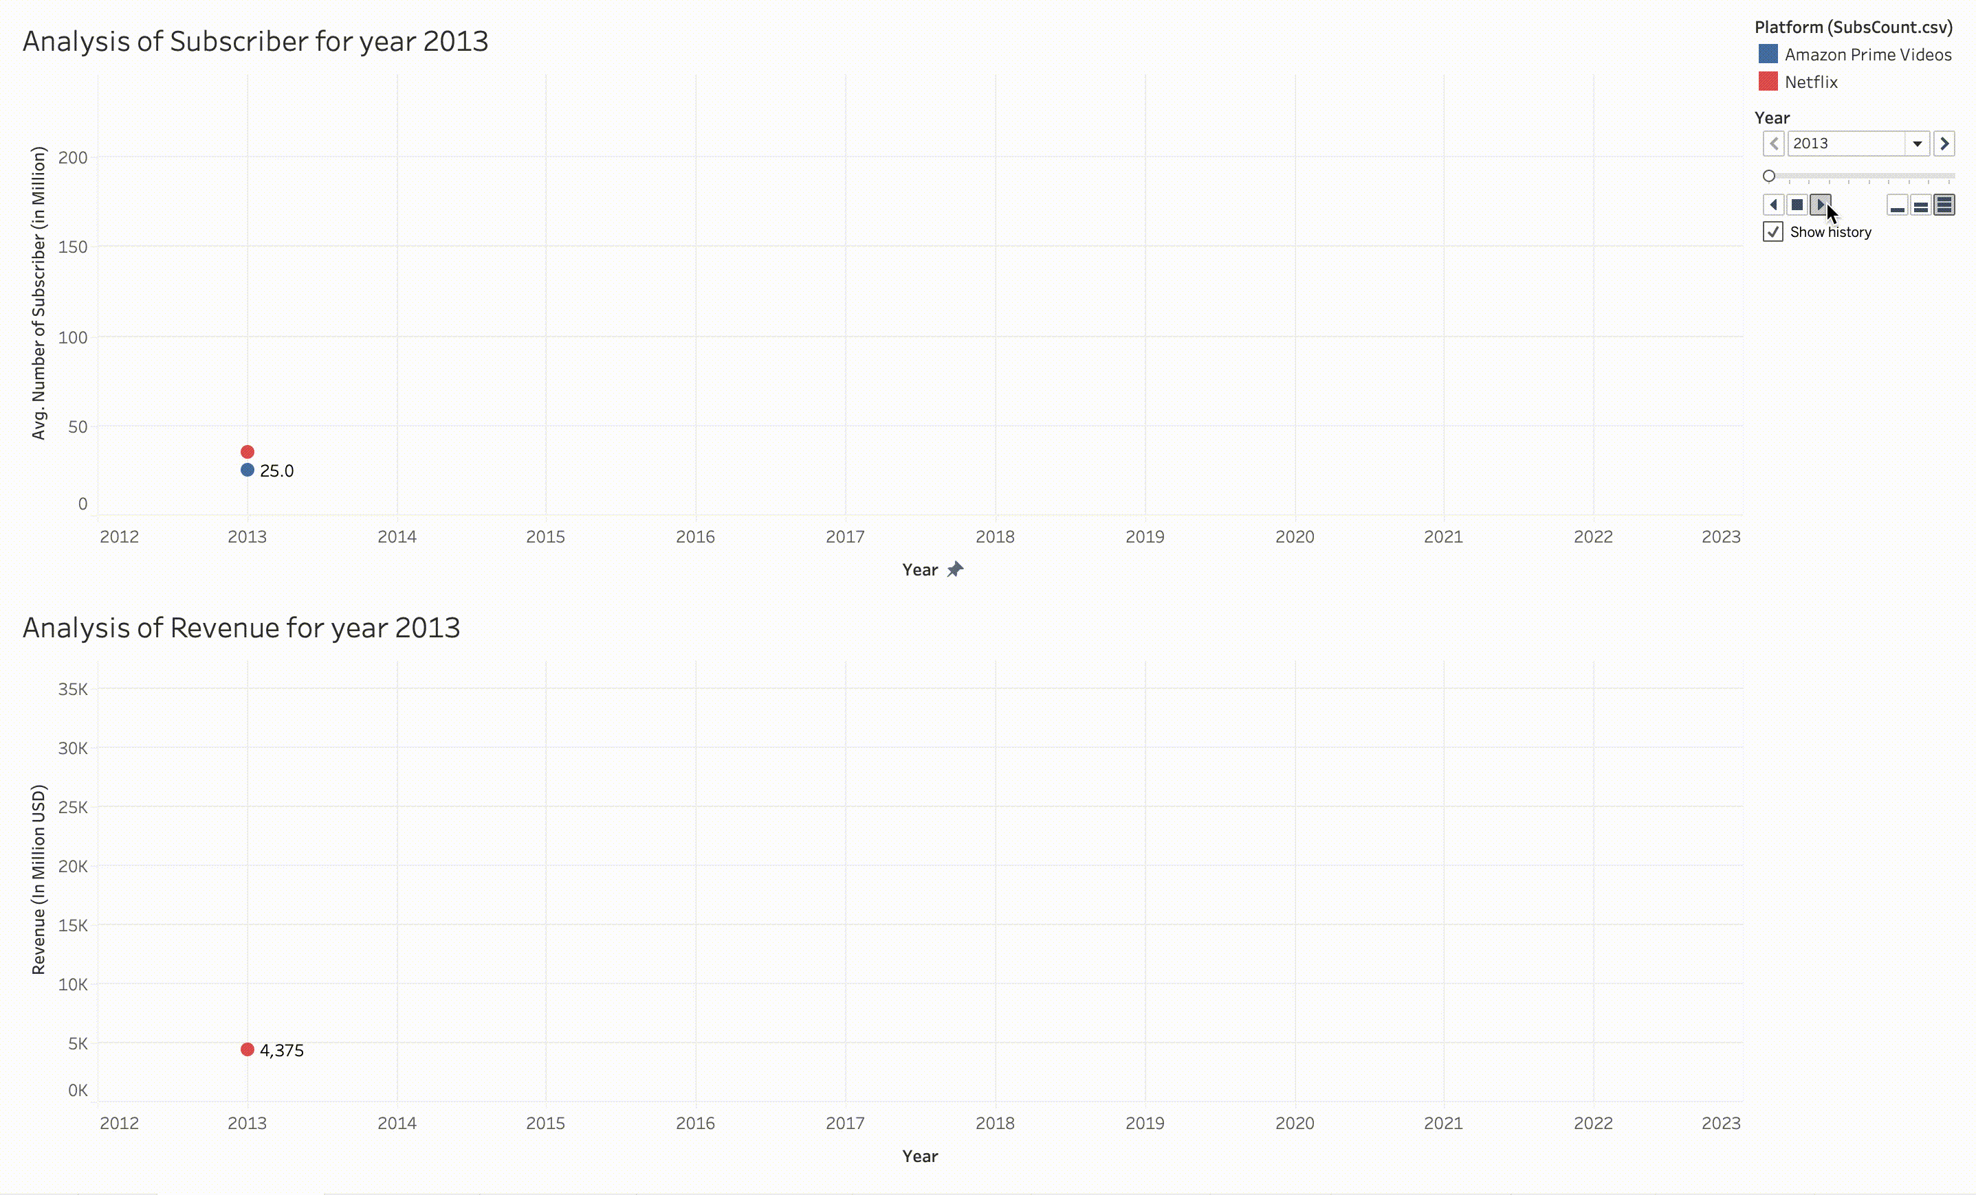
Revenue and Subscriber growth over years

Slide 24
Monetization
Revenue
Content Spend
Active Subscribers

Slide 25

Revenue
Netflix makes money in two ways:
Membership Fees (Monthly, Annual)
DVD Rentals (Monthly)
Amazon Prime:
Subscription (montlhly, annual)

Slide 26
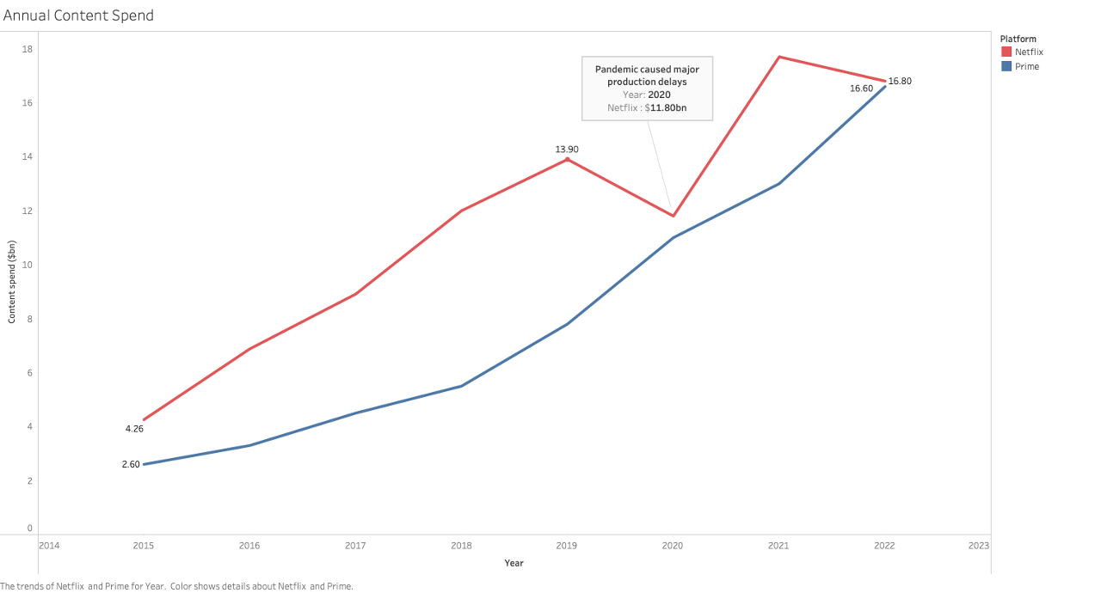
Content Spend

Slide 27
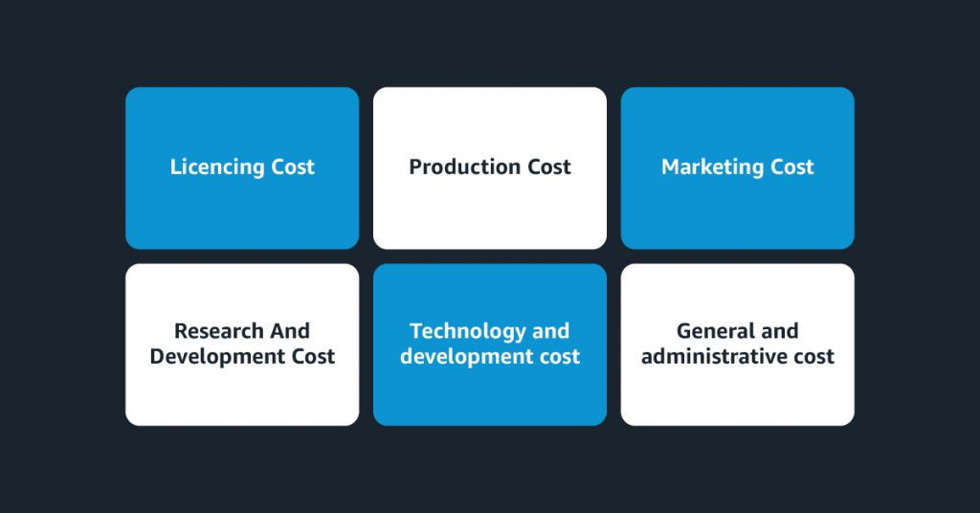
Amazon PrimeVideo acquisition strategy
Provides a bundle system with users accessing video streaming, music, photos, exclusive deals, and express shipping.
Acquired MGM Production Studio for $8.8Bn, adding 4000 exclusive movies to the platform.
Comes with a freemium model, student discount and cheaper subscription cost.

Slide 28
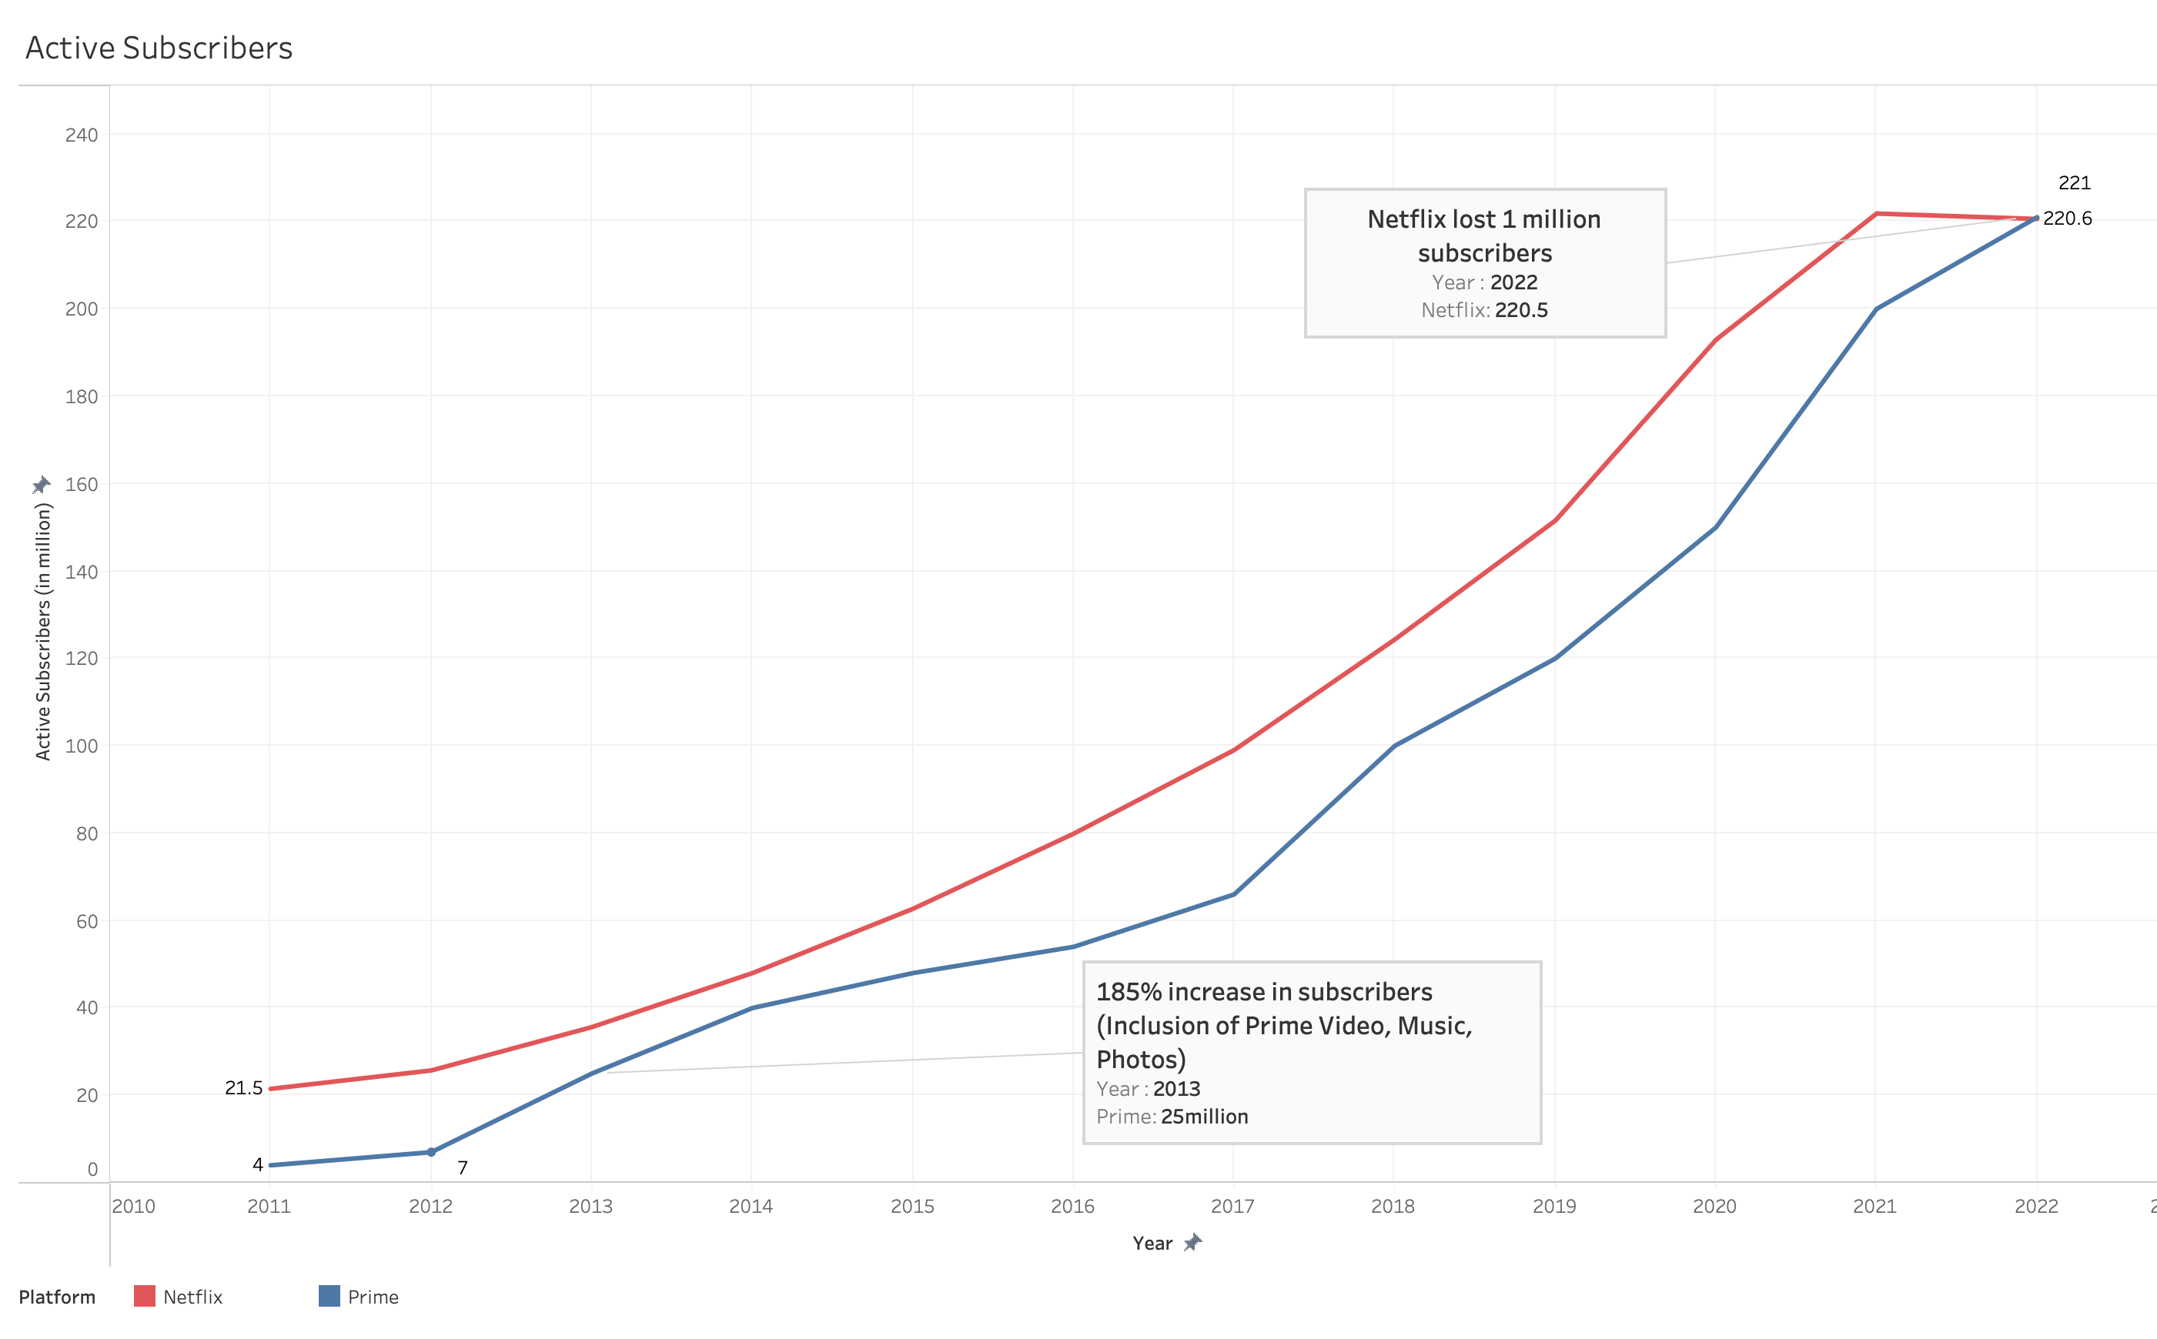
Active Subscribers

Slide 29
Netflix Market Drop
Netflix topped the streaming market until the start of 2022. However, they lost 1 million subscribers by the end of the year.
First ever huge customer loss and realized a serious competition in the market. (Disney, HBO, Hulu, Showtime)
Major problem was, 41% of the users access platform without paying.
4 out of 10 users aren't monetizable.

Slide 30

Why Engagement?
Analyze User Behavior
Improve Customer Experience
Increase Revenue
Increase Retention
Marketplace Competition

Slide 31

"View Hours"

Slide 32
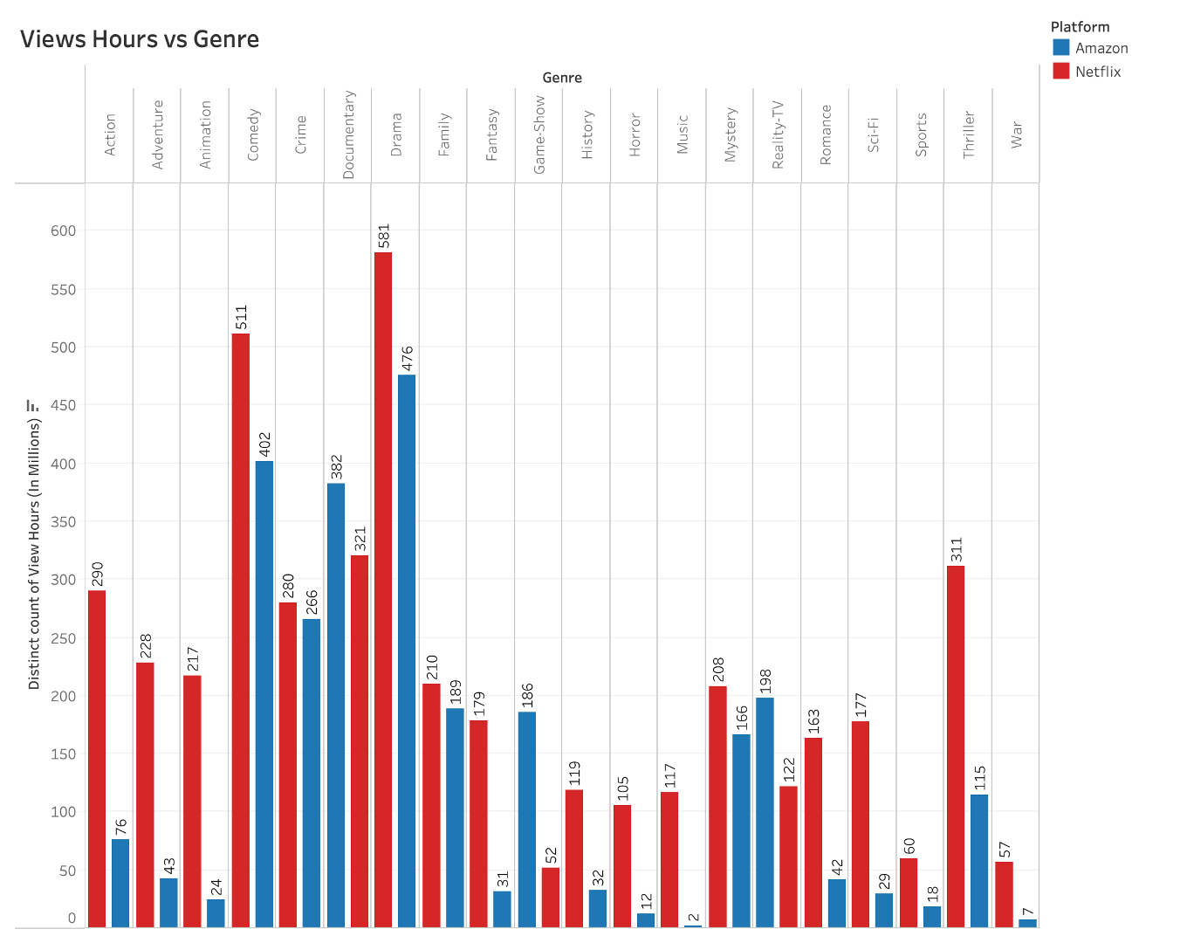
View Hours vs Genre

Slide 33
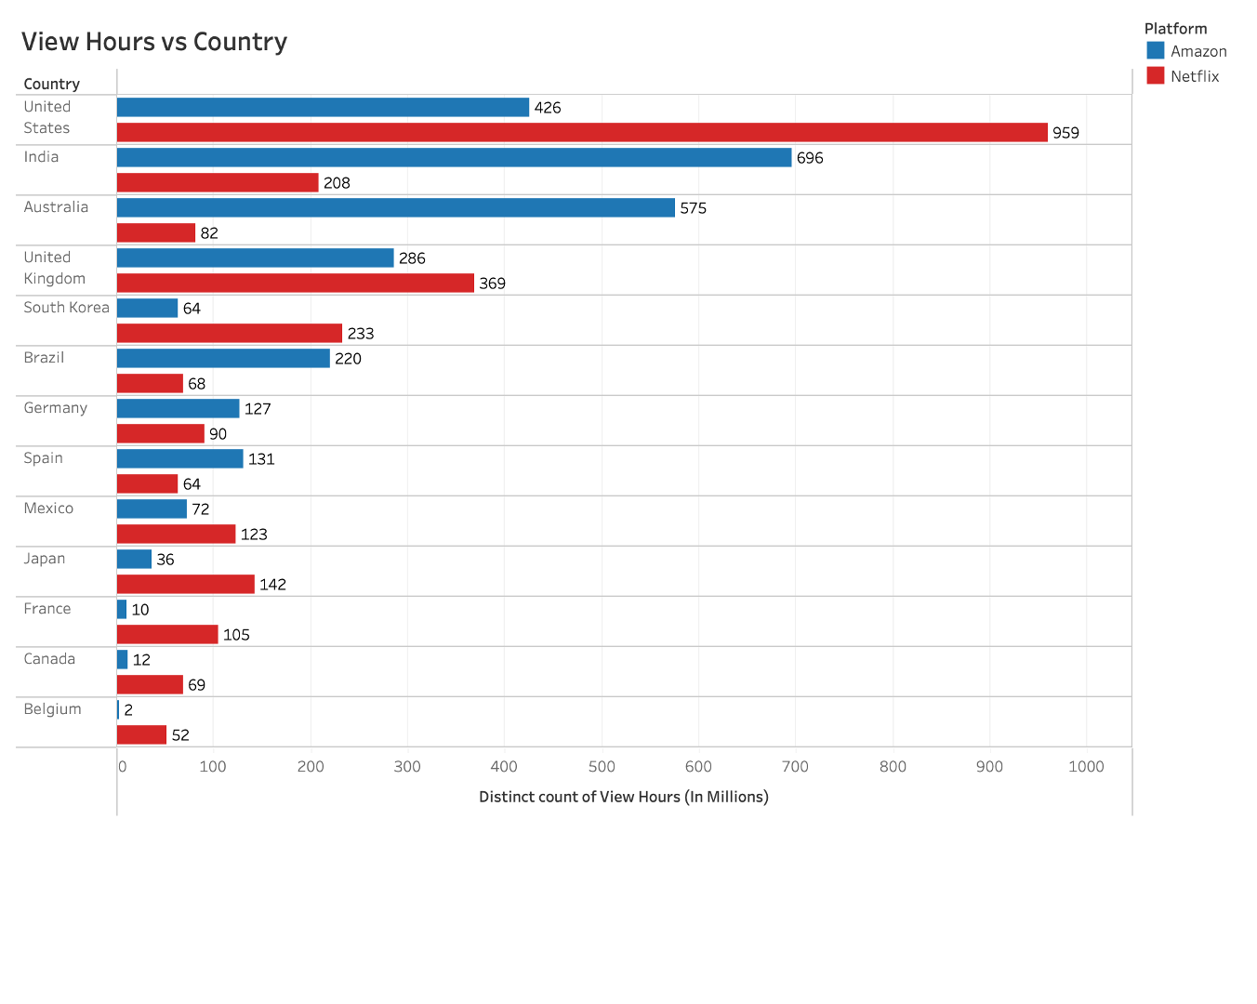
View Hours vs Country

Slide 34
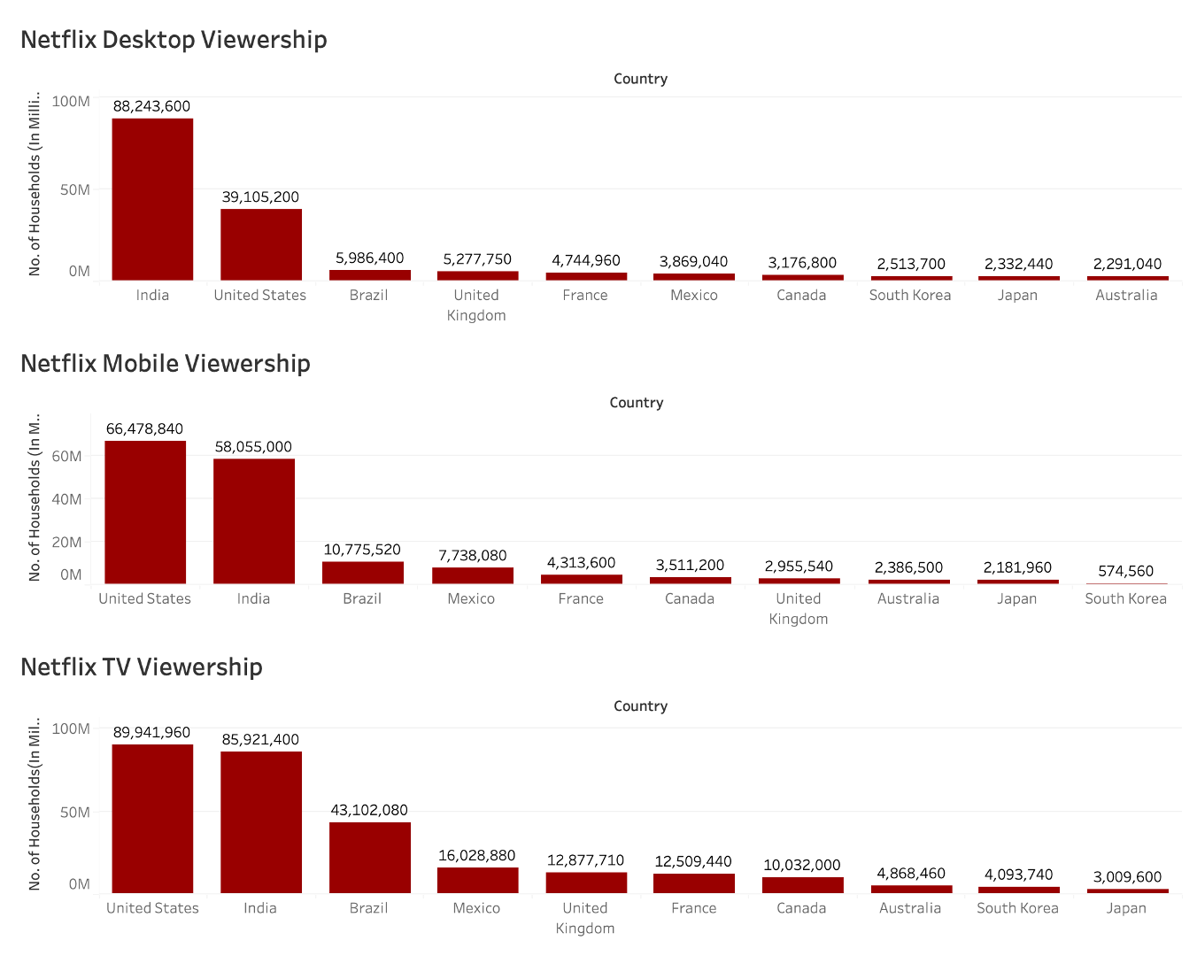
Netflix Viewership Platform-wise

Slide 35
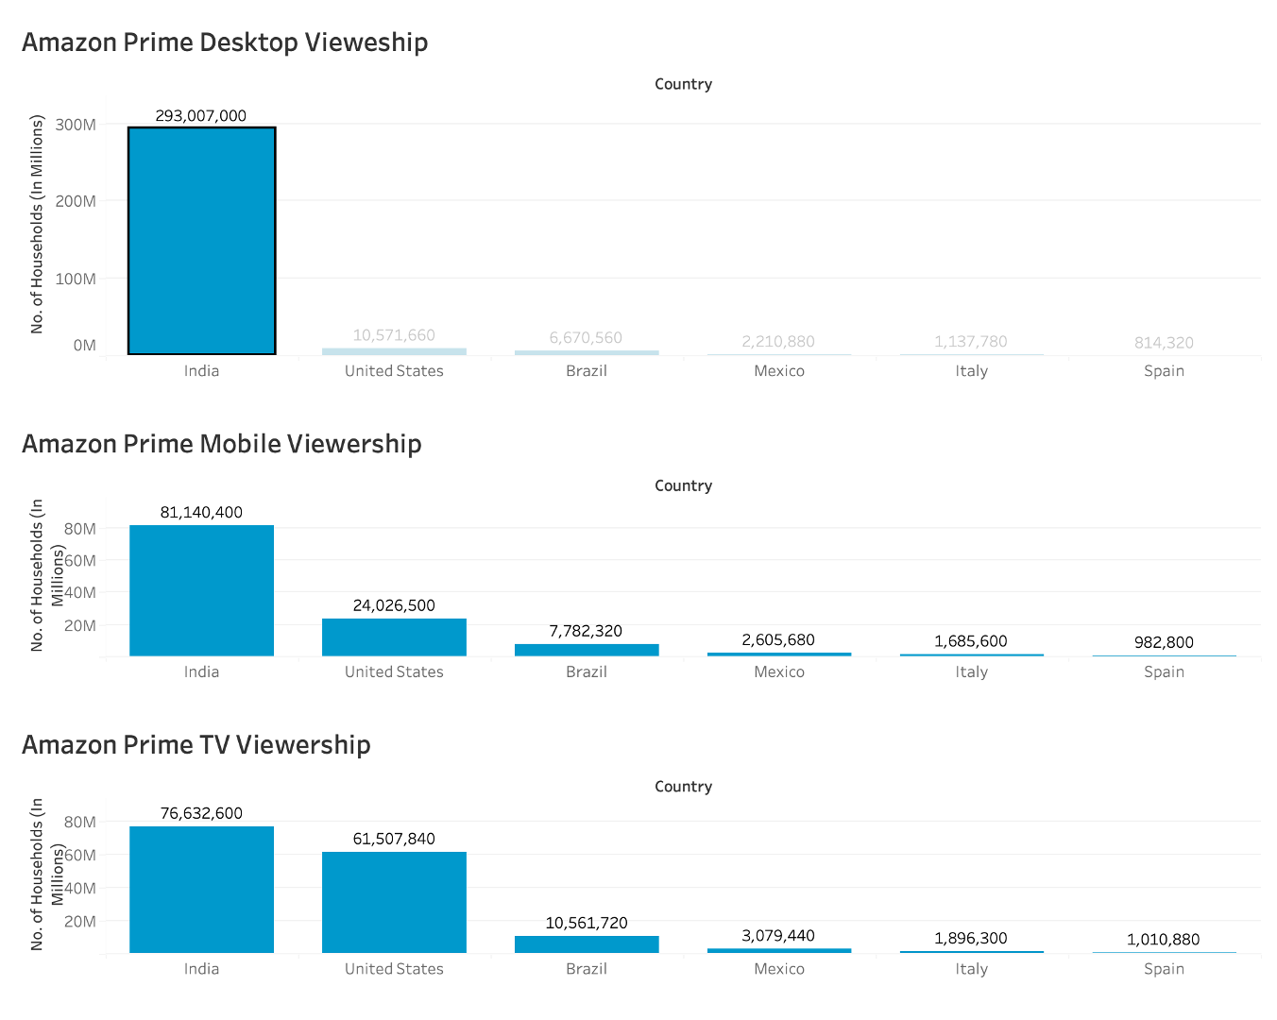
Amazon Prime Viewership Platform-wise

Slide 36
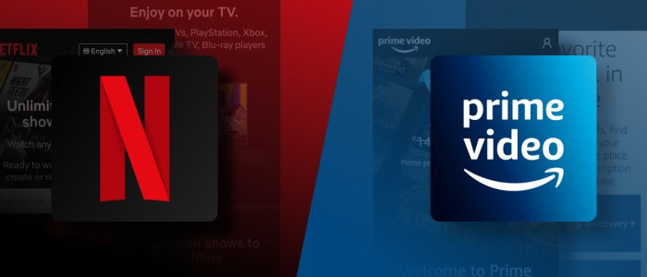
Conclusion

Slide 37

Thank you!

